Slide 1
Pancreas tx 2003-2015

Slide 2
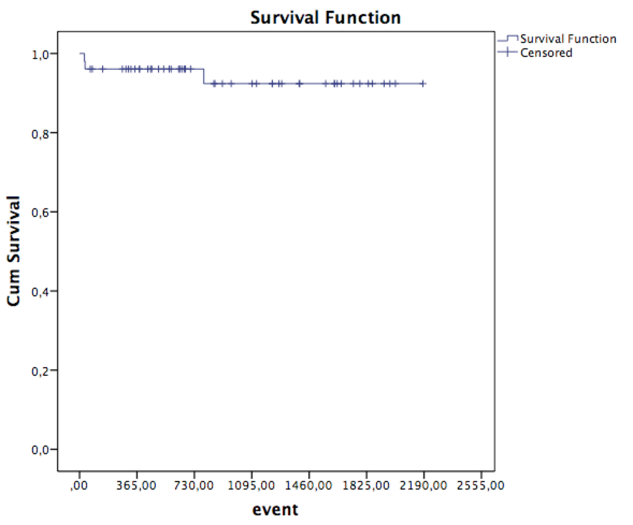

Slide 3
