Slide 1
The Nordic Pediatric Renal Transplant Study Group
1994-2018

Slide 2
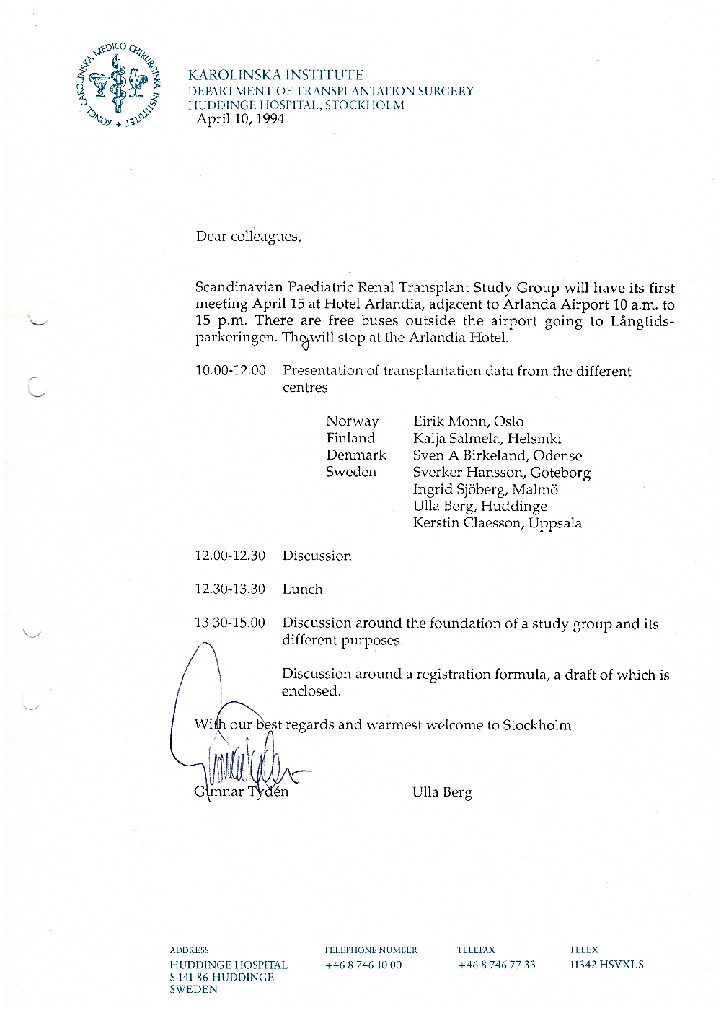
NPRTSG 25 year
The first meeting was held at Arlanda in April 1994
The purpose of the group would be:
to build a common database with data on all children transplanted in the Nordic countries
to exchange experiences
to possibly do joint studies
Simplified registration with retrospective data from 1982 and a complete registration from 1 January 1994

Slide 3
Pediatric renal transplantation in the Nordic countries
Retrospective study 1982-1993
Total: 332

Slide 4
The Nordic Pediatric Renal Transplant Study Group
Aarhus B Jespersen S Rittig
Copenhagen I M Schmidt S S Sørensen
Odense H Thiesson K E Larsen
Helsinki T Jahnukainen H Jalanko
Oslo A Bjerre R Horneland
Gothenburg S Westphal L Mjörnstedt
Malmö Z Bekassy A Biglarnia
Stockholm M Herthelius L Wennberg
Uppsala G Celsi A Sedigh
Reykjavik V Edvardsson
Coordinator M Tranäng

Slide 5
Pediatric* renal transplantation in the Nordic countries
Total:979
* Recipient age < 16 years

Slide 6
Pediatric* renal transplantation in the Nordic countries
Total:979
* Recipient age < 16 years

Slide 7
Pediatric renal transplantation in the Nordic countries Age distribution/year
Total: 979

Slide 8
Pediatric renal transplantation in the Nordic countries
 | No | % | Weight Mean±SD Median (range) | Age Mean±SD Median (range) | Sex
All | 979 | 100% | 27.7±16.1 24.0 (7.4-103.5) | 8.5±5.1 9.3 (0.7-15.9) | 593 M, 386 F 61% M, 39% F
< 2 yrs | 170 | 17.4% | 10.7±1.5 10.6 (7.4-15.7) | 1.4±0.3 1.4 (0.7-1.9) | 105 M, 65 F 62% M, 38% F
2-5 yrs | 153 | 15.6% | 13.8±2.4 13.6 (9.4-22.3) | 3.2±0.9 3.1 (2.0-4.9) | 100 M, 53 F 65% M, 35% F
5-12 yrs | 322 | 32.9% | 25.9±7.8 24.3 (13.5-67.5) | 8.9±1.9 9.0 (5.0-11.9) | 194 M, 128 F 60% M, 40% F
12-16 yrs | 334 | 34.1% | 45.3±12.6 44.0 (22.0-103.5) | 14.2±1.2 14.2 (12.0-15.9) | 194 M, 140 F 58% M, 42% F

Slide 9
Age distribution of renal tx in Nordic children – 1st tx only
Age at tx | < 2 yrs | 2-5 yrs | 5-12 yrs | 12-16 yrs
Finland (n=224) | 38% | 19% | 21% | 22%
Sweden (n=326) | 15% | 14% | 35% | 36%
Norway (n=168) | 15% | 14% | 30% | 40%
Denmark (n=177) | 5% | 17% | 45% | 33%
Iceland* (n=8) | - | 25% | 50% | 25%
Estonia** (n=1) | - | 100% | - | -
* 6 patients transplanted in Reykjavik, 1 in Copenhagen, 1 in Gothenburg between 2004-2018
** 1 patient transplanted in Helsinki in 2017

Slide 10
Age distribution of renal tx in Nordic children
Age at tx | < 2 yrs | 2-5 yrs | 5-12 yrs | 12-16 yrs
Finland (n=237) | 36% | 19% | 22% | 23%
Sweden (n=353) | 15% | 13% | 36% | 36%
Norway (n=180) | 14% | 14% | 30% | 42%
Denmark (n=200) | 4% | 16% | 42% | 38%
Iceland* (n=8) | - | 25% | 50% | 25%
Estonia** (n=1) | - | 100% | - | -
* 6 patients transplanted in Reykjavik, 1 in Copenhagen, 1 in Gothenburg between 2004-2018
** 1 patient transplanted in Helsinki in 2017

Slide 11
Age distribution of renal tx in Nordic children
 | No | % | Age Mean±SD Median (range)
DD | 408 | 42% | 8.7±5.1 9.4 (0.8 – 15.9)
LD | 571 | 58% | 8.4±5.1 8.8 (0.7 – 15.9)
All | 979 | 100% | 8.5±5.1 9.2 (0.7 – 15.9)

Slide 12
Pediatric renal transplantation in the Nordic countries

Slide 13
Pediatric* renal transplantation in the Nordic countries
% LD
81 %
71 %
50 %
29 %
Iceland: 7 LD, 1 DD
Estonia: 1 DD
* Recipient age < 16 years

Slide 14
Pediatric* renal transplantation in the Nordic countries
* Recipient age < 16 years

Slide 15
Pediatric* renal transplantation in the Nordic countries Patients in dialysis at first tx, LD
 | Finland |  | Denmark |  | Norway |  | Sweden
 | n | % in dialysis | n | % in dialysis | n | % in dialysis | n | % in dialysis
2004-2018 | 48 | 83% | 57 | 53% | 83 | 41% | 158 | 59%
2014-2018 | 22 | 73% | 17 | 65% | 25 | 16% | 44 | 59%
* Recipient age < 16 years

Slide 16
Pediatric* renal transplantation in the Nordic countries Combined transplantation
Tx period: 1994-2018
Total no of tx: 979
Combined liver+kidney tx: 28 (27 recipients)
* Recipient age < 16 years

Slide 17
Graft survival* 2004-2018
p< 0.05
54% of the graft losses occurs at the age above 16
* Censored for death with a functioning graft

Slide 18
Patient survival 2004-2018
ns
* Donor type at first transplant

Slide 19
Graft survival* 2004-2018
* Censored for death with a functioning graft

Slide 20
Graft survival* 2004-2016
* Censored for death with a functioning graft

Slide 21
Patient survival 2004-2018

Slide 22
Patient survival 2004-2018

Slide 23
Pediatric* renal transplantation in the Nordic countries AB0i transplantation
* Recipient age < 16 years

