Slide 1
Graphs from annual report 2018

Slide 2
Total number of organs transplanted and patients waiting for organs within Scandiatransplant

Slide 3
Utilized deceased donors in numbers in Scandiatransplant

Slide 4
Utilized deceased donors pmp in Scandiatransplant

Slide 5
Transplanted patients in Scandiatransplant 2018

Slide 6
Organs imported from other EOEO’s to Scandiatransplant

Slide 7
Organs exported to other EOEO’s from Scandiatransplant

Slide 8
Organs exported and imported between Scandiatransplant countries and other EOEO’s

Slide 12
Number of deceased donors where organ(s) were offered

Slide 13
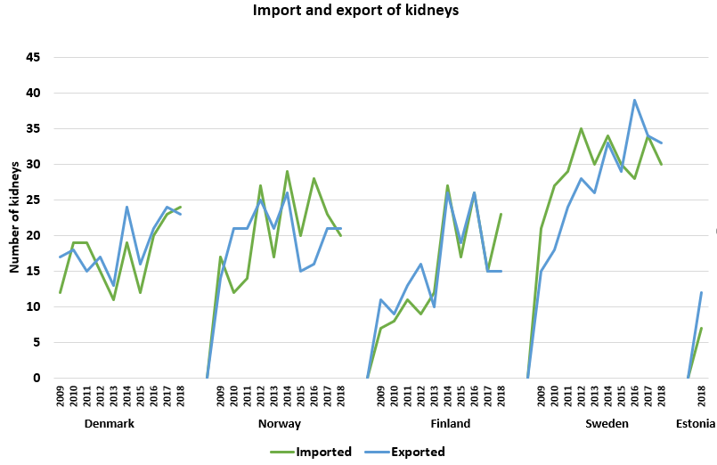
Kidneys exported and imported between the Scandiatransplant countries

Slide 14
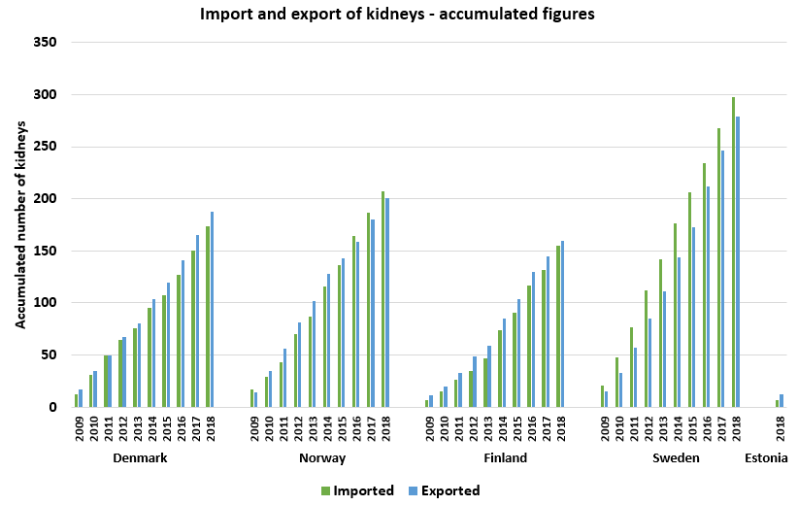

Slide 15
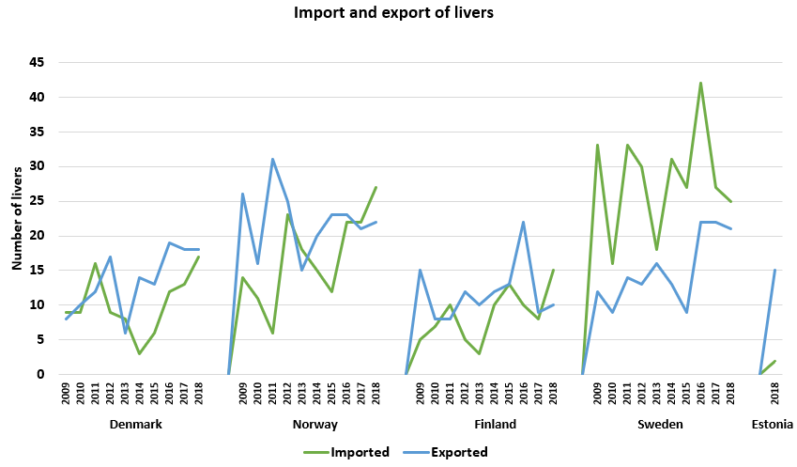
Livers exported and imported between the Scandiatransplant countries

Slide 16
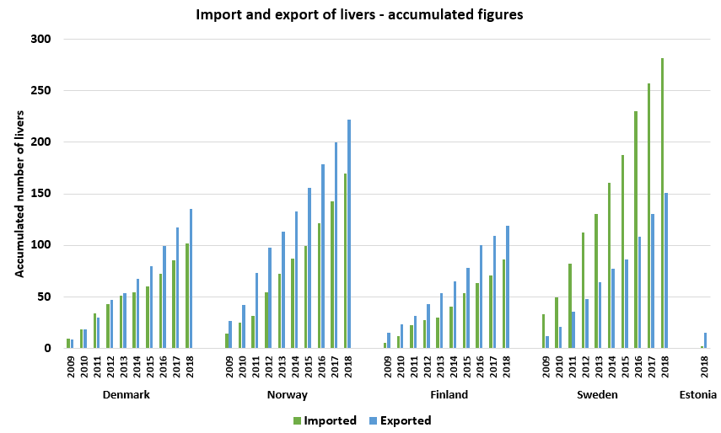

Slide 17
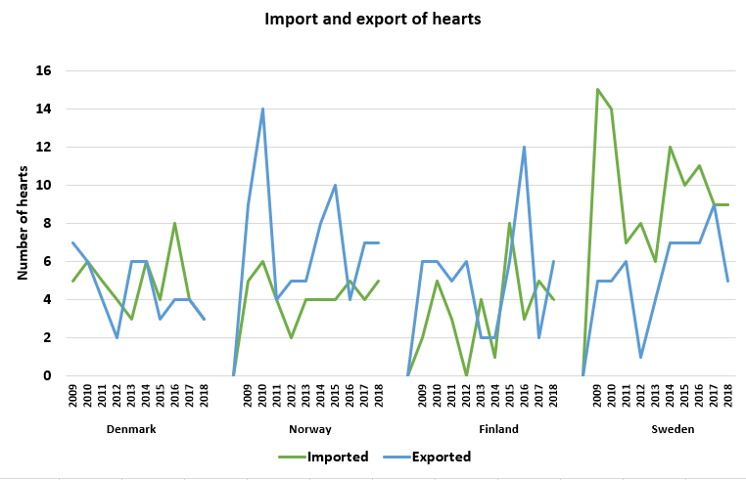
Hearts exported and imported between the Scandiatransplant countries

Slide 18
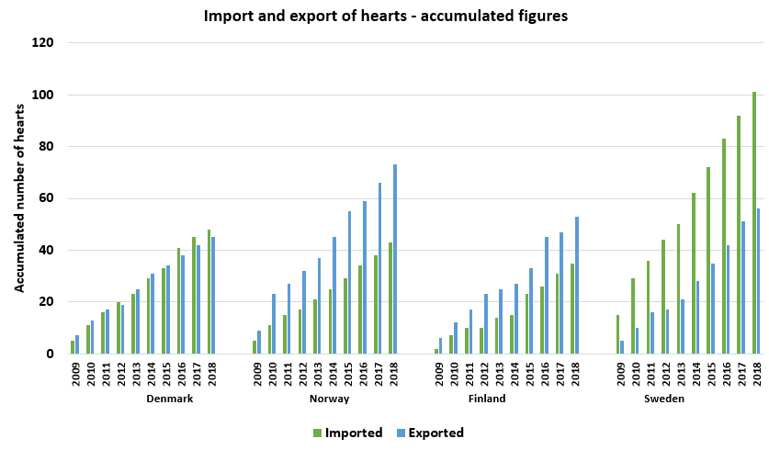

Slide 19
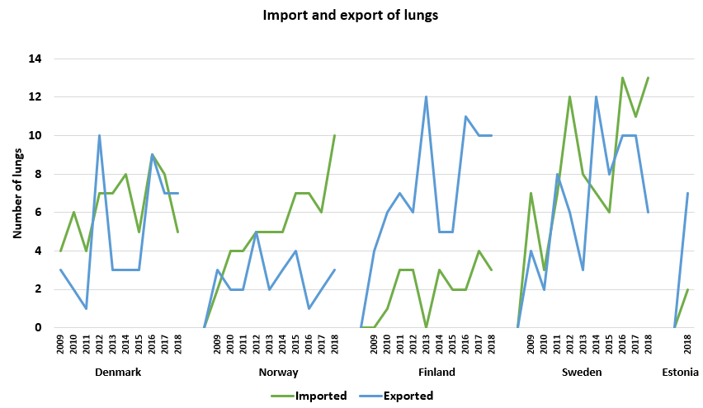
Lungs exported and imported between the Scandiatransplant countries

Slide 20
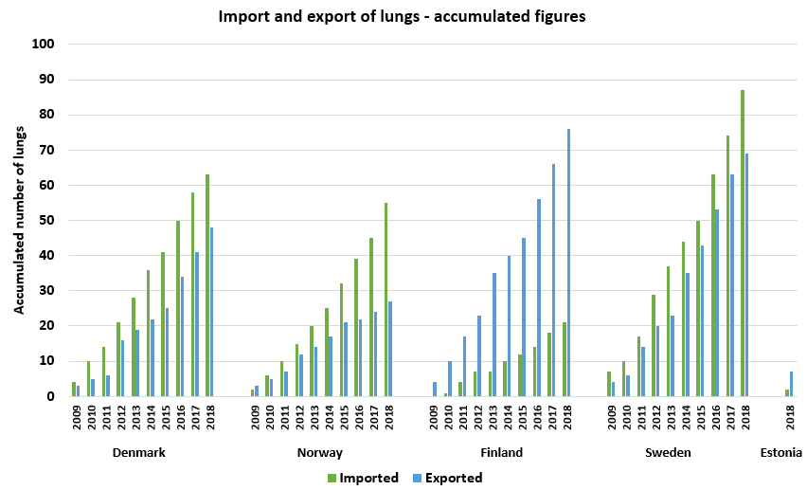

Slide 21
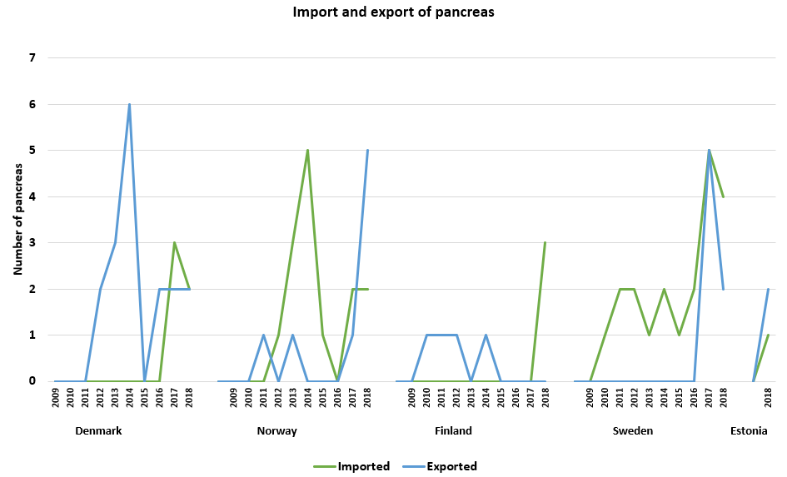
Pancreas exported and imported between the Scandiatransplant countries

Slide 22
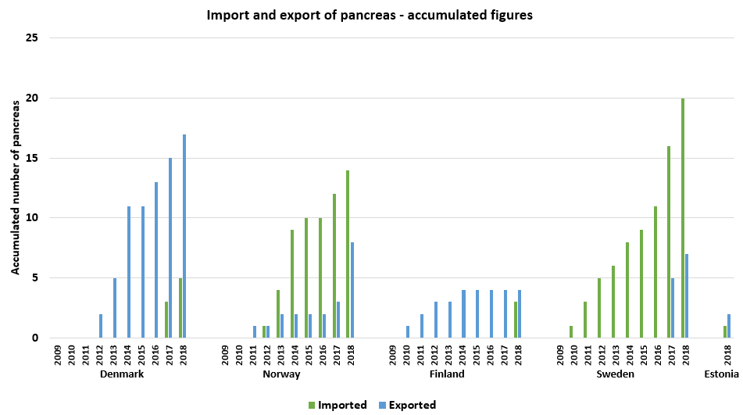

Slide 23
Kidneys 2018

Slide 24
Transplanted kidneys pmp from deceased donors per year

Slide 25
Transplanted kidneys pmp from living donors per year

Slide 26
Livers 2018

Slide 27
Transplanted livers (Deceased and living donors) pmp per year

Slide 28
Hearts 2018

Slide 29
Transplanted hearts pmp per year

Slide 30
Lungs 2018

Slide 31
Transplanted lungs (Double, single and heart-lung) pmp per year

Slide 32
Pancreas 2018

Slide 33
Transplanted pancreas (incl. combined kidney-pancreas) pmp per year

